Slide 1



Stay quiet,
and Run wild
Mobile Resource Scheduling for
Time Competing Stations
Presenter：叶璨铭(YeCanming)

Slide 2



目录
CATALOGUE
Introduction
to MRS-TCS
Three Dimensional Formulation
Heuristic and MetaHeuristic Methods
Experiments
2

Slide 3

1
Introduction to
Mobile Resource Scheduling for
Time Competing Stations

Slide 4
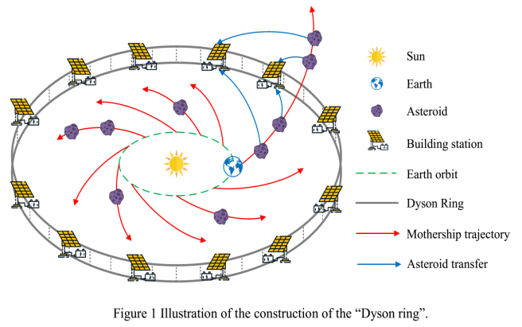


Background
From GTOC to SpoC
Notes:
Yes, No

Slide 5

Mobile Resource Scheduling for
Time Competing Stations
Station
Resource(Asteroids)
Time Competing
Mobile Resource
Scheduling
Notes:
Yes, No

Slide 6
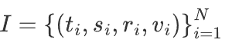

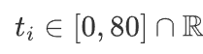
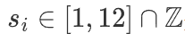
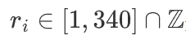
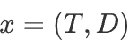
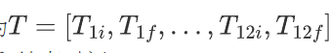
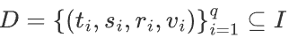
Bare Formulation for MRS-TCS
Instance Representation
delivery time
station number
resource number
Solution Representation
time windows
Occurrence Deliveries
Notes:
Yes, No

Slide 7
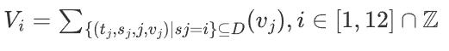
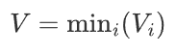
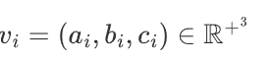
Bare Formulation for MRS-TCS
Objective
Constraints
Time windows: intersect, 1 day
Deliveries: in window,
Extensions
value space can be overloaded.
Notes:
Yes, No

Slide 8

Confusing Related Problems
Introduction
Assignment
Scheduling
Dispatching
Delivery
Matching

Slide 9

2
Three Dimensional Formulation

Slide 10
Bare Formulation for MRS-TCS
Direct Optimization does not work, why?
Many unecessary constraints
Mix of Discrete and continuous vars
Too high dimenional
Notes:
Yes, No

Slide 11
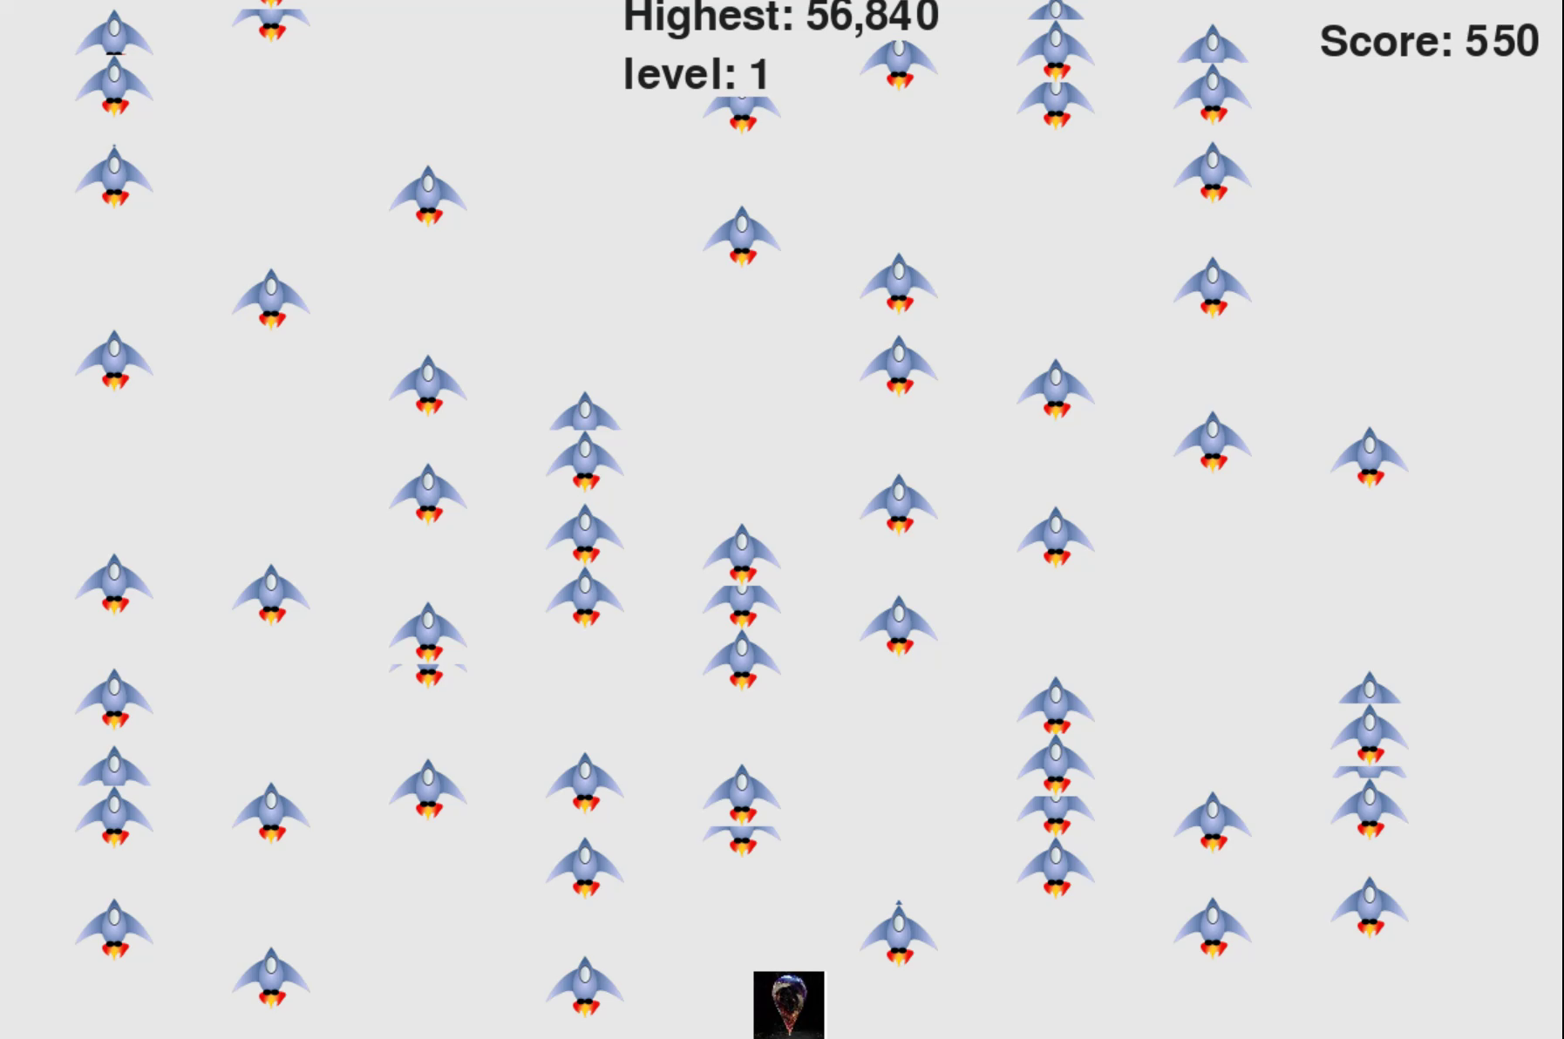
Let’s play a game first...

Slide 12
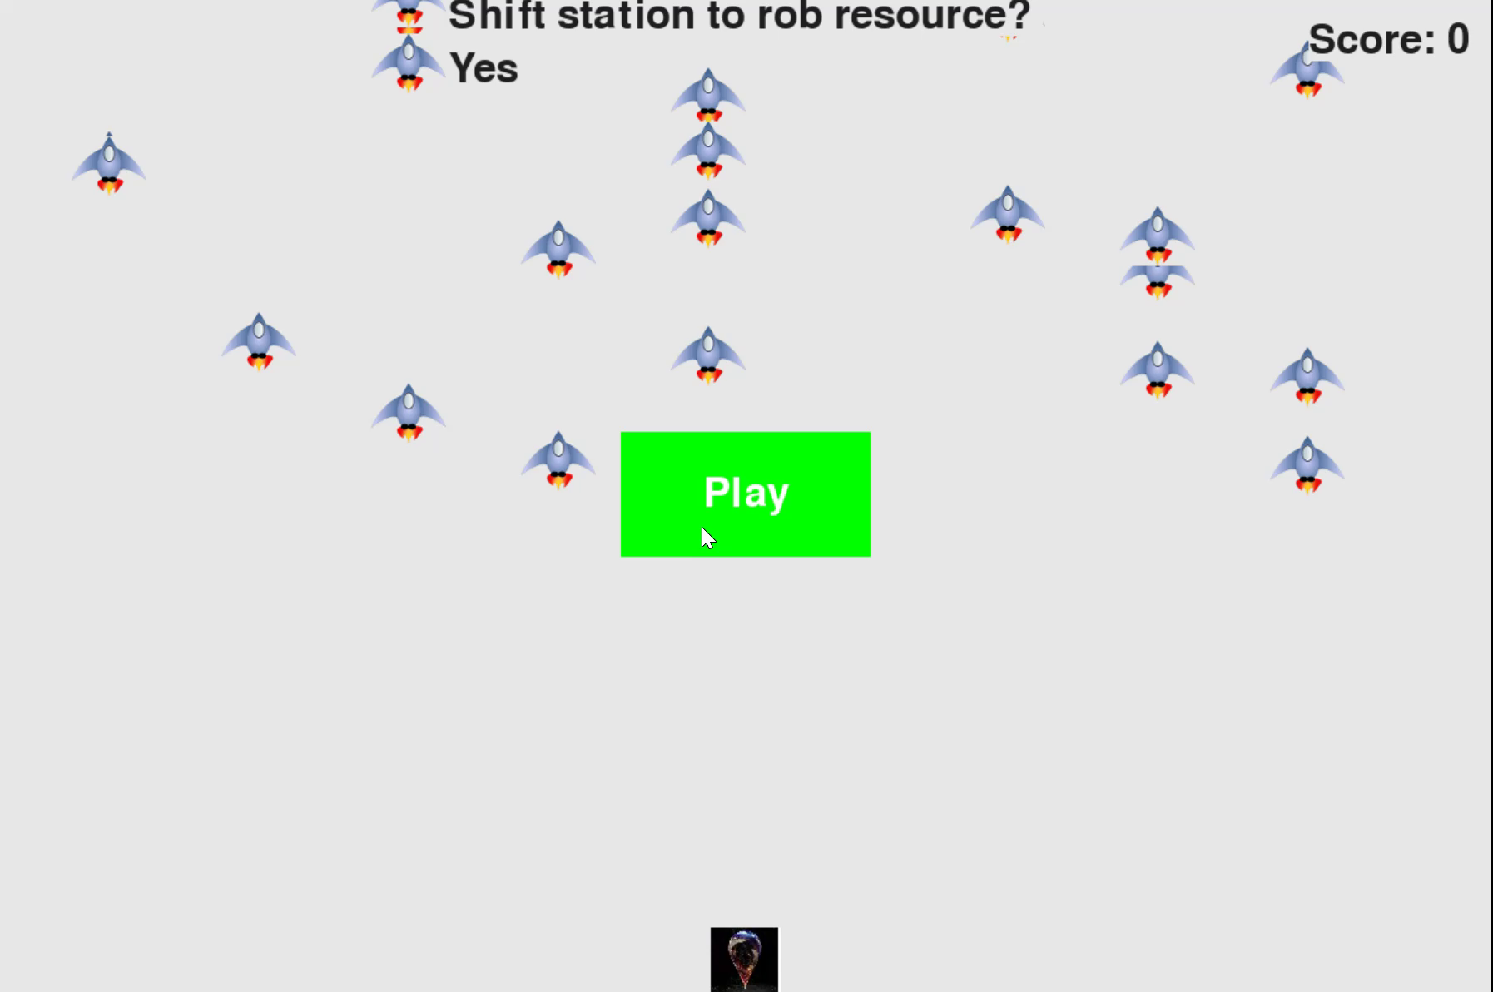
Sounds easy, what’s next?

Slide 13

Dynamic Programming
for the game
Other variables
Problem Instance I,
which is the occurence list
Action
shift (to another station) or not
give up (don’t shift, but give up) or not
State
occurence time rank
current station, banned stations
banned resource ids
Notes:
collected resource values, previous min resource value 是下一个问题

Slide 14
Dynamic Programming
for the game
State`
time rank= 1
Bellman equation
State`
time rank= 1
State
time rank= 0
State`
time rank= 1
Polynomial if #stations and #resources
are constants. O(2^S*2^R*T*S)
State`
time rank= 1

Slide 15
Back to our problem
We have eliminate all constraints
sorting to time is the key insight
The decision space is fully discrete
the rank but not the time is important

Slide 16
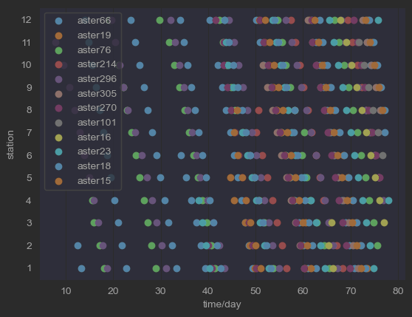
First Dimension：the Viewpoint
Three Dimensional Formulation

Slide 17
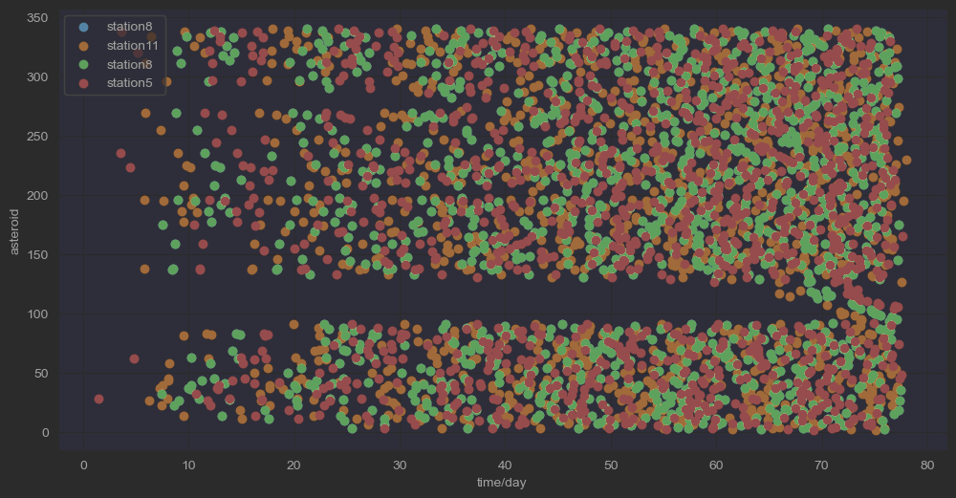
The Asteroid Viewpoint
Three Dimensional Formulation

Slide 18
Third Dimension：
Single or Multi Objective
Three Dimensional Formulation
Absolute Opimal Solution
Pareto Opimal Solution

Slide 19
Third Dimension：
Single or Multi Objective
Three Dimensional Formulation
Single Objective reduces to Multi
Multi is at least not easier than Single

Slide 20
Second Dimension：
Static or Dynamic
Three Dimensional Formulation
Dynamic as we have seen
State Inference can reduce the search size, explained later
Static
Actions are done together.
Useful for shifting actions, explained later

Slide 21
Our Formulation：
Stay quiet
Run wild

Slide 22
3
Heuristic and MetaHeuristic
Methods

Slide 23
Heuristics 1: Equal Shifting

Slide 24
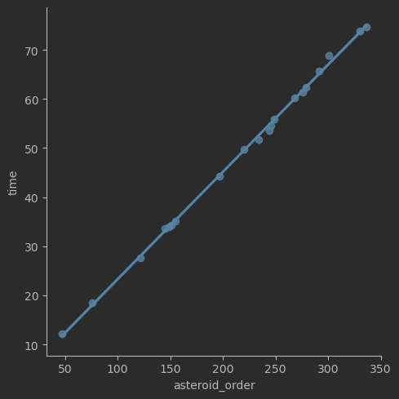
Heuristic 2: Greedy Preempt
Notes:
重要的启发：倒过来走，效果一定很好。手动赋予小行星优先级。

Slide 25
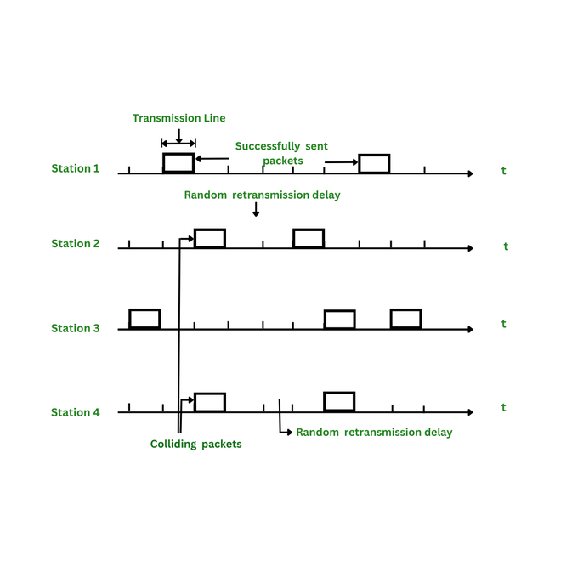
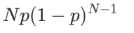
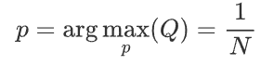
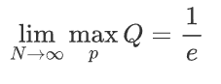
Heuristic 3: Slotted ALOHA
Famous Random Access Protocol in Link Layer
p = P(station tries), N=#Stations
Q = P(asteroid is used)=
0.3839 when N =12

Slide 26
MetaHeuristics: NSGA3

Slide 27
MetaHeuristics: Simple GA

Slide 28
MetaHeuristics:
Softmin Fitness scaling

Slide 29
MetaHeuristics: DQN

Slide 30
4
Experiments

Slide 31
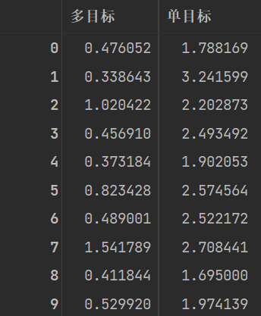
Ablation Experiments 1
Single Objective vs Multi Objective
#population = 100
#gen= 20
Mannwhitneyu Test
stat =100.0
p=9.134e-05

Slide 32
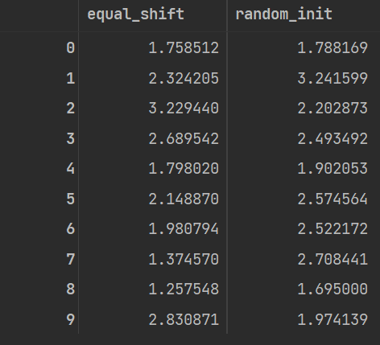
Ablation Experiments 1
Equal Shifting vs No initial value
Under Single Objective.
Mannwhitneyu Test
stat =42.0
p= 0.7397

Slide 33
Ablation Experiments 1
Slotted ALOHA vs Greedy Preempt
Under Single Objective.
With Equal Shifting
Mannwhitneyu Test
stat =
p=

Slide 34

Experiment Plots

Slide 35
4
Future Plans

Slide 36
Future Plans
Reinforcement Learning Algorithms Fails to work
NN cannot learn the policy, value, Q functions
Maybe Bad Rewards Shaping
Maybe need a better NN design

Slide 37
Future Plans
Asteroid Viewpoint not yet Implemented
for static, new evolving OPs needed
for dynamic, Monte Carlo Search Tree is useful
Similar to a special Go after sorting

Slide 38

Thanks

